Slide 1
STOCK VISULIZATION
Team Members Details
K.ASHRUTH REDDY :22N31A6779
K.SUBHASH RAJ :22N31A6793
M.VIJAYASRI VIGNATHA :22N31A67A1
III Year B.Tech I Semester – CSE-DATA SCIENCE
Under the Guidance of
Mr G. Raghavendar
Assistant Professor

Slide 2
Abstract
This project aims to demonstrate the capabilities of the Dash framework in Python for visualizing stock data and forecasting future trends.
Through interactive web applications, users can explore historical stock prices, perform technical analysis, and deploy forecasting models to predict future price movements.
Leveraging libraries such as Plotly and Pandas, the application provides intuitive visualizations and allows for customization to suit individual preferences.
The project showcases the fusion of data visualization and predictive analytics in the realm of stock market analysis, empowering users to make informed investment decisions.

Slide 3
Introduction
In the realm of finance, understanding historical trends and predicting future stock prices is essential for making informed investment decisions.
By leveraging Dash's intuitive interface and powerful visualization capabilities, we aim to create a platform that enables investors to effortlessly explore historical stock data and generate accurate forecasts.
Through the integration of reliable financial data sources and advanced forecasting models, users will gain valuable insights into market trends and potential investment opportunities.
Our goal is to provide investors with a simple yet effective tool for visualizing and forecasting stocks, that empower them to navigate the complexities of the stock market with confidence and ease.

Slide 4
Existing System
Manual Analysis: Users manually collect stock data from various sources like financial websites or APIs and perform analysis using tools like Excel or specialized software.
Limited Interactivity: Visualizations are static or have limited interactivity, making it challenging for users to explore the data dynamically.
Forecasting Tools: Some existing systems offer basic forecasting tools, but they are not customizable or accurate enough for advanced analysis.
Limited Accuracy: Existing Systems often struggle with accurately predicting stock movements, especially during volatile market conditions.

Slide 5
Proposed System
The main goal of our project is to precisely predict the future closing price of stock over a period of time in future.
In this project we have used dash html components and core components to create the website’s structure and to enhance the site’s UI and CSS for styling.
Plots of data are generated by using the plotly library of python and the data is fetched using Yfinance.
Machine learning models will be utilized for predicting the stock price at a particular date requested by the user.

Slide 6
Architecture Diagram or
System Diagram

Slide 7
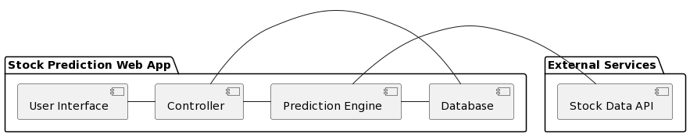
System Architecture

Slide 8
Software Requirements Specification (SRS)

Slide 9
Software Requirement (SRS)
  Python
  Pandas and NumPy
  Plotly , Dash and Yfinance
  PyCharm / Vscode
  Machine Learning

Slide 10
Hardware Requirement
  O.S:- Windows 10, Mac or Linux
  Processor:- Intel core i5 or i7
  RAM:- 1GB
  ROM:- 512GB

Slide 11
Application Modules
User Interface (UI) Modules:
  Welcome Message
  Stock Code Input
  Date Range Picker
  Viewing Stock Price
  Forecasting Future Prices etc.
Buttons for Actions :
  Submit Button
  Get Stock Price Button
  Selecting Date Range

Slide 12
Status of the Application Development
The project is currently in the active development phase, with all requirements gathered and clearly defined. The team is focused on implementing core features, including data retrieval, machine learning model development, and user interface design. We've integrated ‘yfinance’ for stock data and ‘plotly’ for visualizations, with ongoing work to optimize the model and refine the UI Deployment planning has begun, with considerations for hosting.

Slide 13
Tentative Date of Application Completion
15 October, 2024

Slide 14
Thank you
K. ASHRUTH REDDY :22N31A6779
K. SUBHASH RAJ :22N31A6793
M. VIJAYASRI VIGNATHA :22N31A67A1

